Slide 1
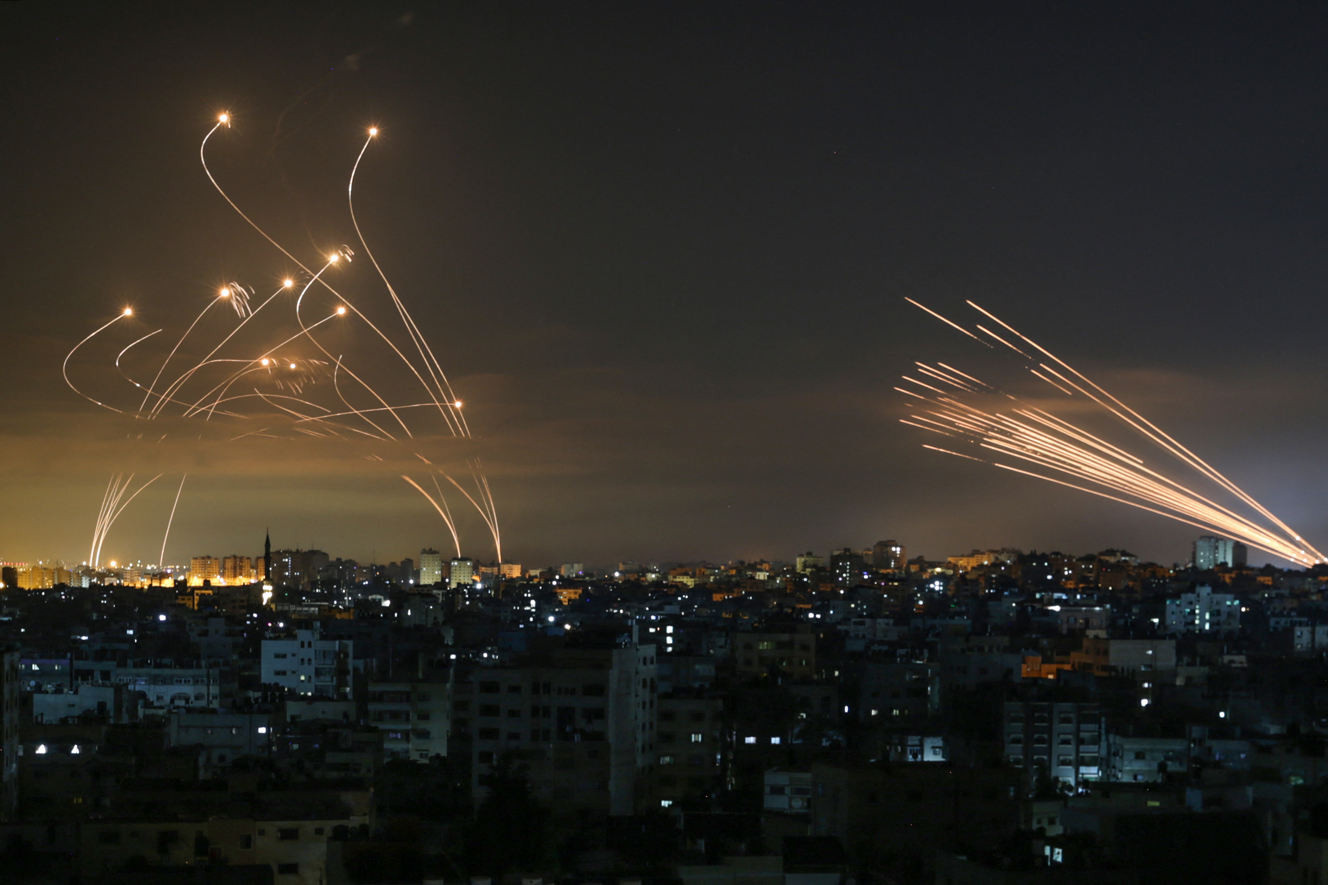

Red alerts analyze
בס׳׳ד
Lidan Danino , Niv Netanel

Slide 2
Raising Research Questions
Data Handling
Machine Learning
Timeline
Data Scraping
EDA
Conclusions

Slide 3

Raising Research Question

Slide 4
Our Question
Is it possible to classify the areas in Israel according to the number of alerts that have been in recent years?
Or is it possible to find cities with similar characteristics and different geographical location?

Slide 5


Data Scarping

Slide 6

Data Source
https://www.oref.org.il/
we used Selenium to navigate automatically in the website we want to crawling, until we find the table with all the data we looking for on the site.

Slide 7
The data we Scraped – Rocket Alerts since 2014 - present

Slide 8
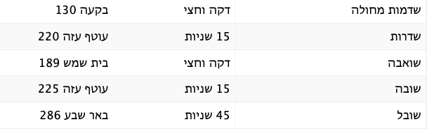
Part of our data is named by area code , so we had to crawling to another website that has all the city names and the area codes and use it to convert all the data we had , we used BeautifulSoup for crawling.
data source: https://www.mivzaklive.co.il

Slide 9

Data Handling

Slide 10
Data Handling
The city of Ashdod is divided into several areas, so we want to turn all those areas into one area called Ashdod.
We separated all the areas into separate rows
We deleted all the ‘Test’ alerts.
We drop all the duplicates
We used the second DataFrame to convert all the area codes we have into city names.

Slide 11
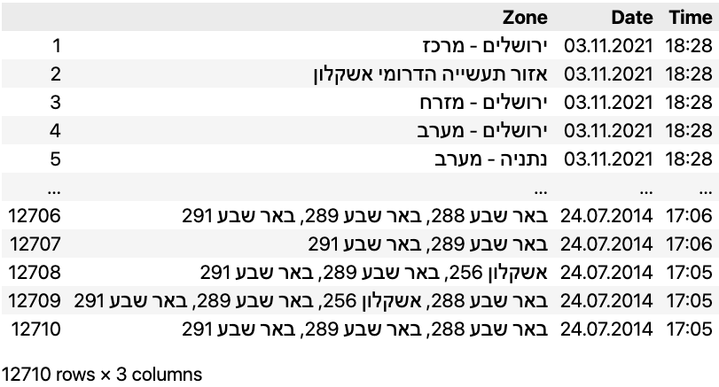
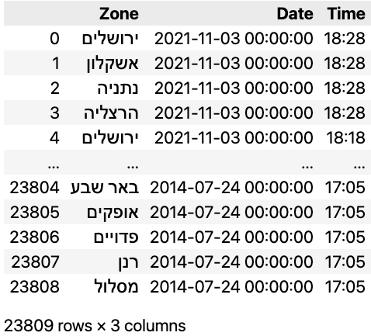
Data Handling

Slide 12


EDA

Slide 13
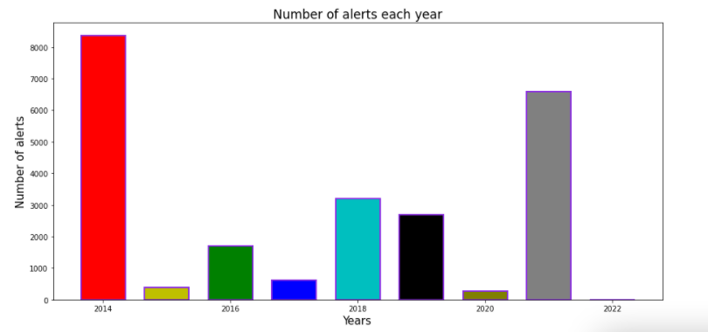
Exploratory Data Analysis

Slide 14
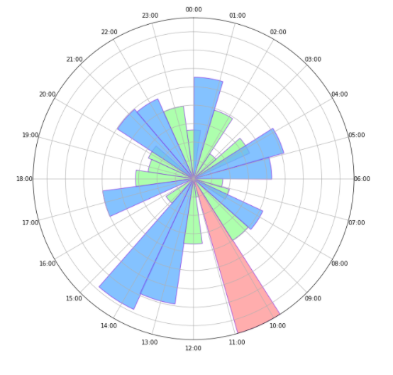
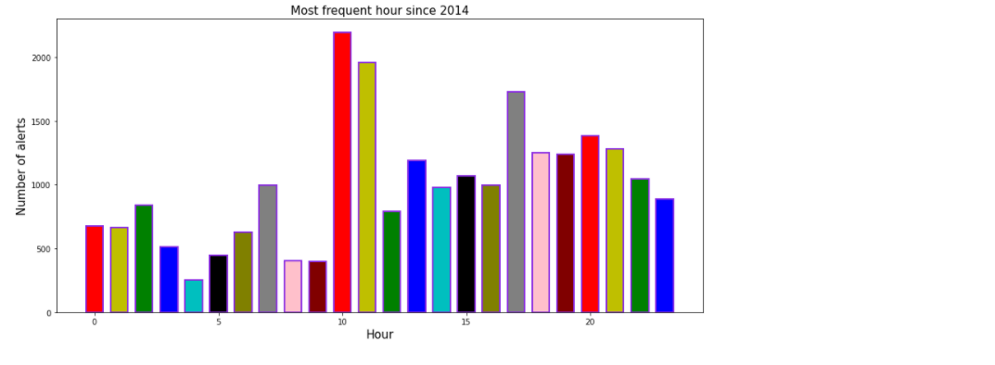
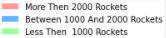
Exploratory Data Analysis

Slide 15

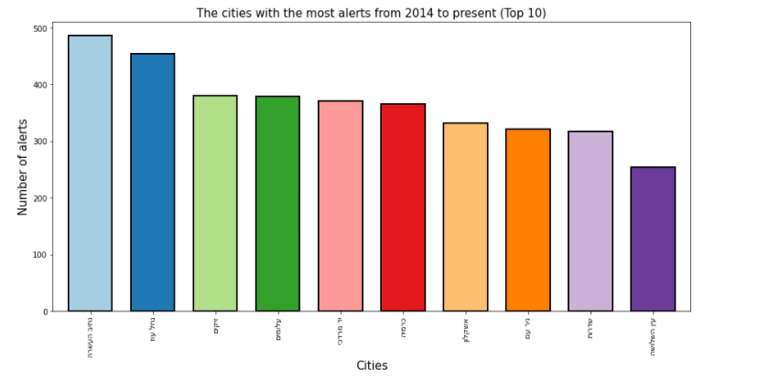
Exploratory Data Analysis

Slide 16
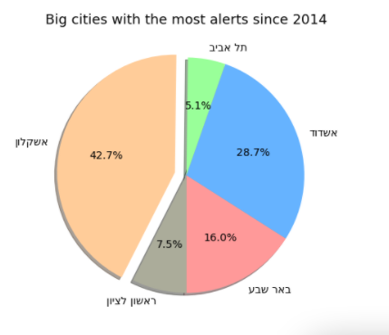
Exploratory Data Analysis

Slide 17
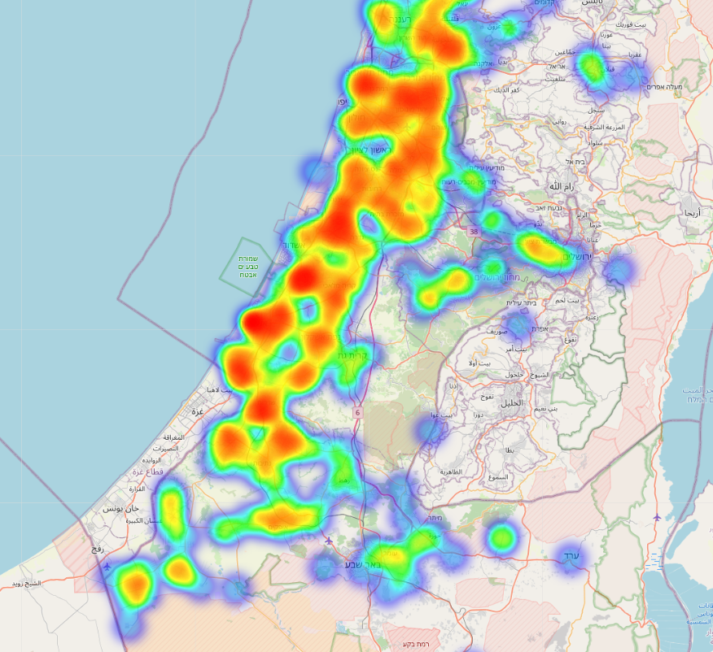
Exploratory Data Analysis
Heat Map
5/2021 – 6/2021 Military Operation

Slide 18

Machine Learning

Slide 19
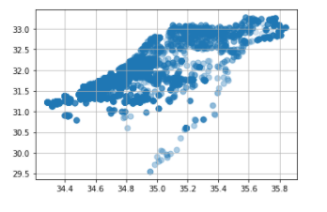
Unsupervised Learning
Our data was not linear, so we used Unsupervised Learning with Kmean method and we will see if we can classify our data according to similar characteristics.
We added the coordinates of each city into dataframe

Slide 20
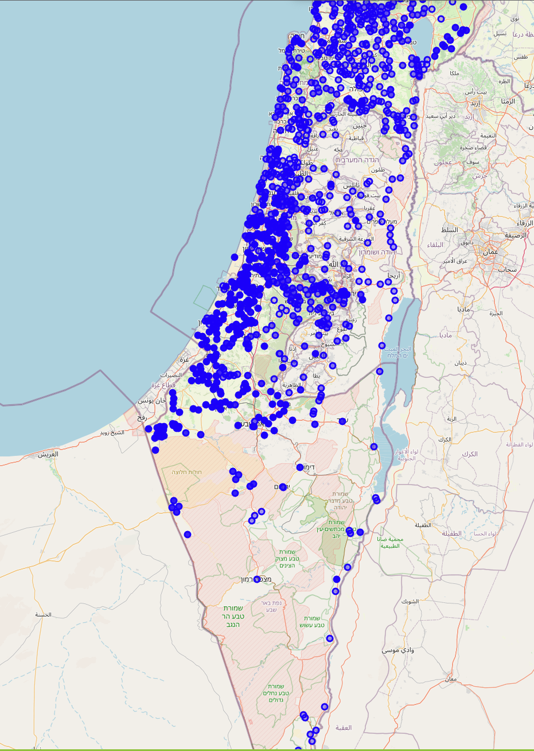
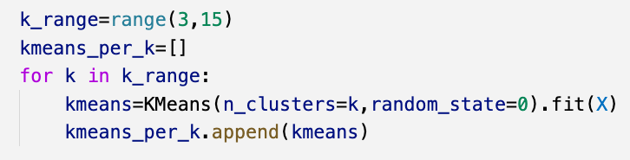
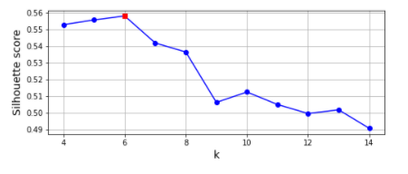
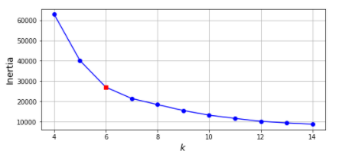
Unsupervised Learning - Kmean
Find best initialization parameters for K-means
Silhouette score
Elbow method
Ccredits: Meghaj Singh (GitHub)

Slide 21
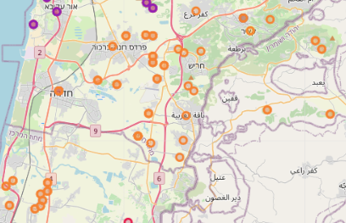
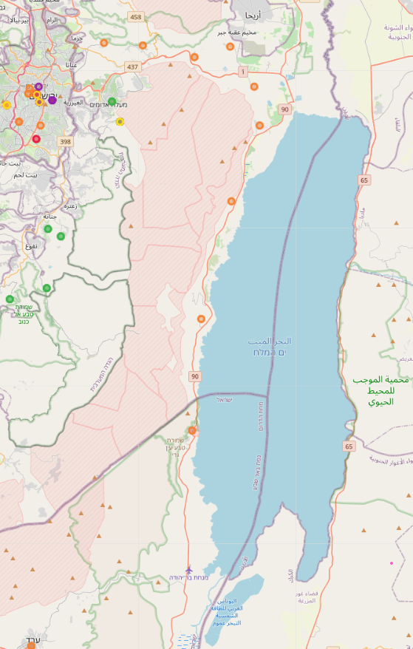
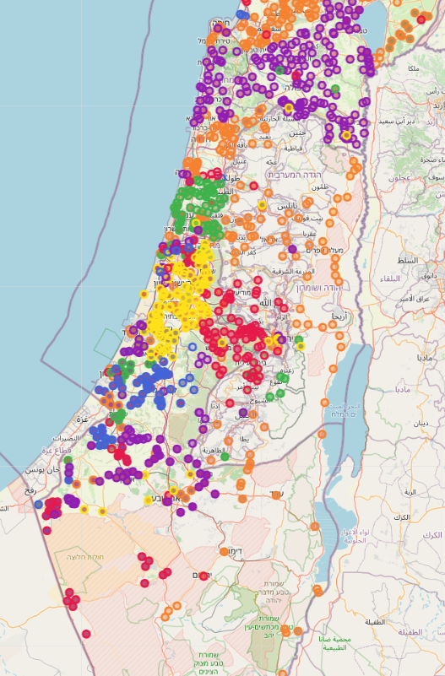
Unsupervised Learning - Kmean
6 clusters
We can see that the machine classified the Dead Sea area and Hadera area as a group with similar characteristics, despite their different geographical location

Slide 22

conclusions
In 2004 there were a total of 8353 alarms - which means that on (about) average of one alarm activated per hour.
And in general between the years 2014-2021 there were aproximitly 23000 alerts so that an average of ten alarms per day
We saw that Ashkelon was the city with the highest number of alerts (of the big cities)
We concluded that there are cities with similar characteristics, despite their different geographical location
We concluded that our data are not linear, so it will be very difficult to predict future events
most frequent hour was 10 am

Slide 23

GitHub link
Thank You!

